Slide 1
C PROGRAMMING
DAY 3
EDUCATION OUTREACH PROGRAM

Slide 2
LET’S REVISE DAY 2
Operators
Type of Operators
Bitwise Operator was left

Slide 3
CONTROL STATEMENTS
They helps us to change the order of execution.
If-else
Loops - for,while,do-while
Goto
switch

Slide 4
If else statements
If can also be executed without else part.
We can have nested if-else statements too.
If else ladder
if(exp)
{ // code }
else
{ // code }

Slide 5

WHILE LOOP
Entry control loop
while(condition)
{ //code }

Slide 6
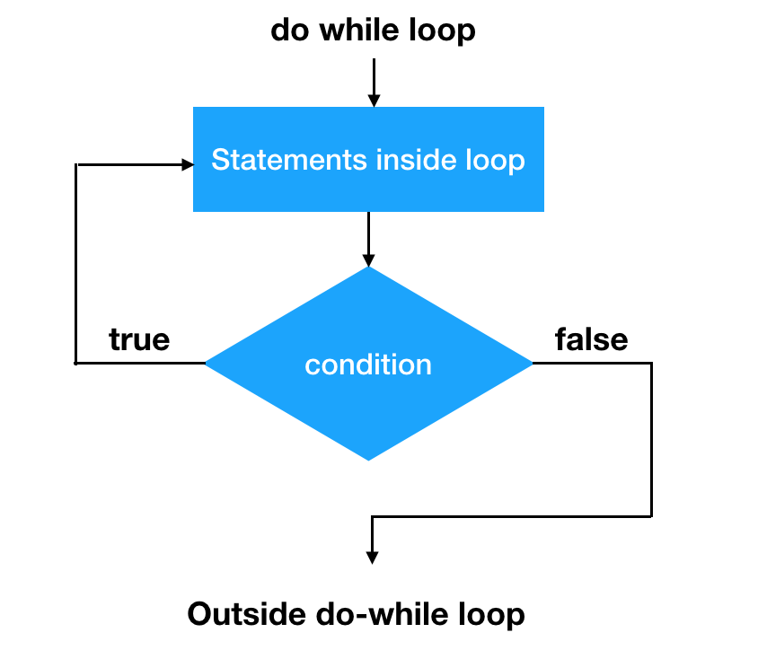
DO WHILE LOOP
Exit control loop
The body of the loop will be executed atleast once.
do
{ //code
}while(condition);

Slide 7
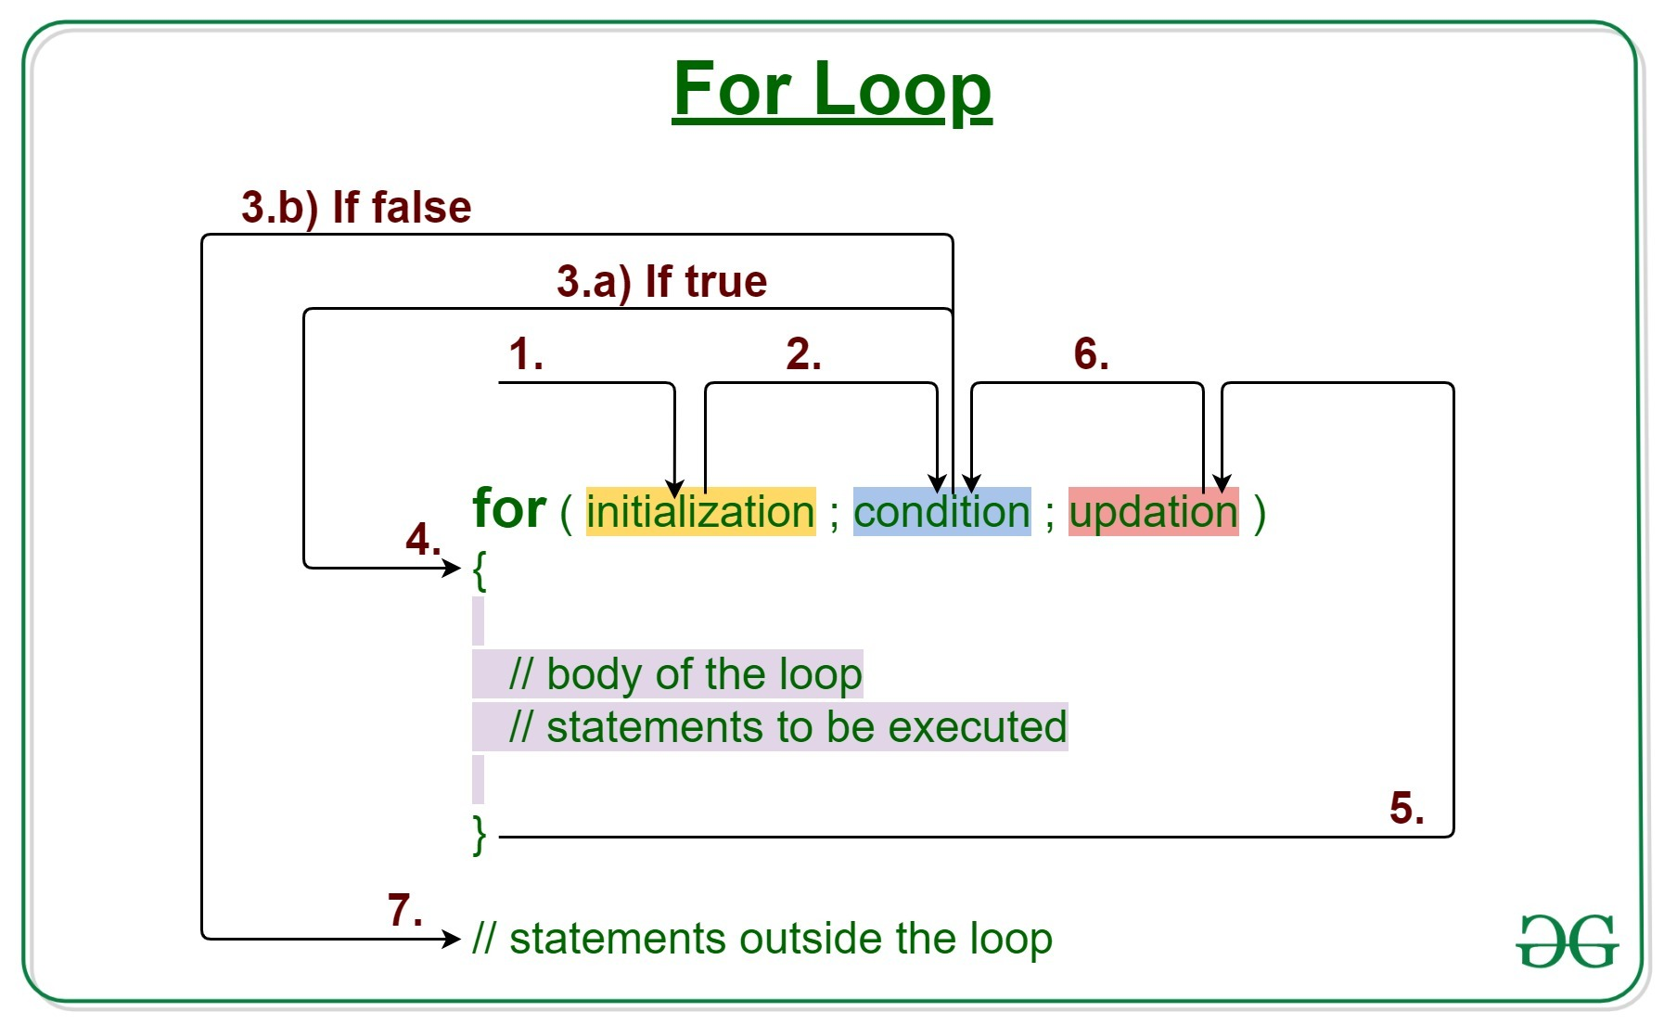
FOR LOOP

Slide 8
NESTED AND INFINITE LOOPS
Same as nested if else
We can also use multiple statements using commas
Lets see some common mistakes that leads to infinite loops.

Slide 9
BREAK AND CONTINUE
Break is used to stop the loop.
Continue is used to skip the statements present in the loop.

Slide 10
GOTO
Unconditional transfer of control
Uses labels , which are also identifiers
Forward jump , backward jump

Slide 11
SWITCH CASE
Useful when we need to choose among various options.
switch(expr){ //int/char
Case 1: //code //int/char/const
Case 2://code
Default : //code
}

